Slide 1
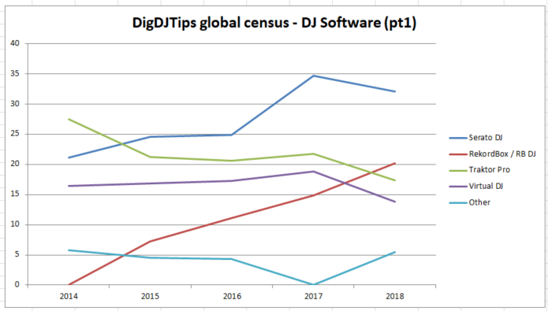




DigitalDJTips - DJ software #1

Slide 2
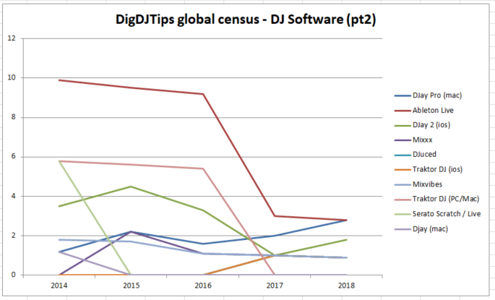
DigitalDJTips - DJ software #2

Slide 3
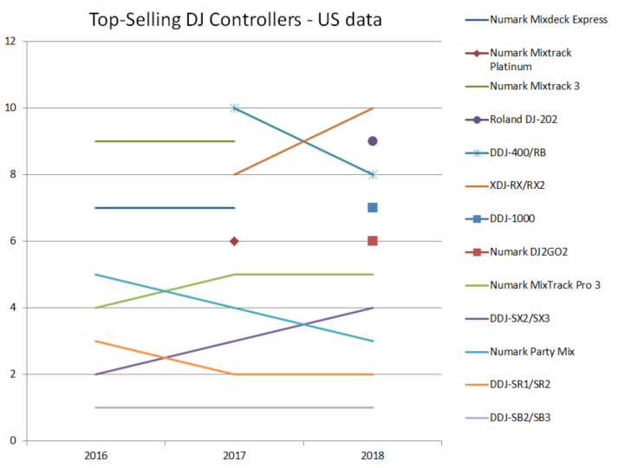
DJTechTools - Top #10 selling controllers

Slide 4
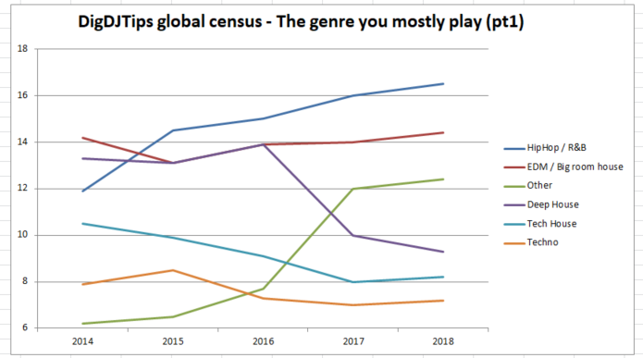
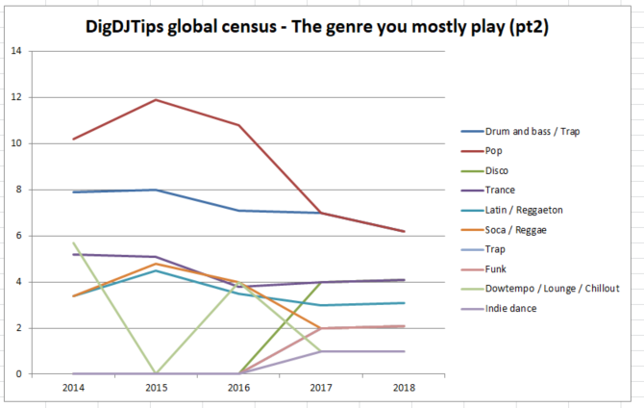
Digital DJ Tips – Most popular genres

